Slide 1
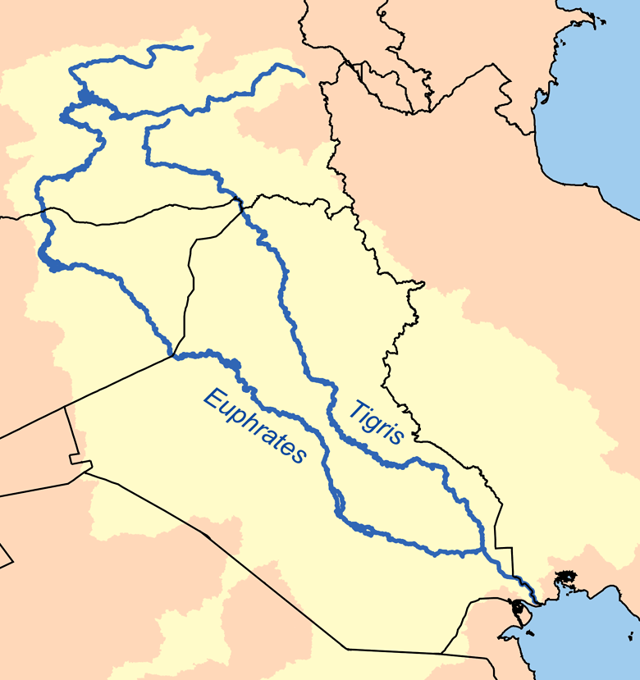
Zagros Mountains
Iran
Iraq
Kuwait

Slide 2
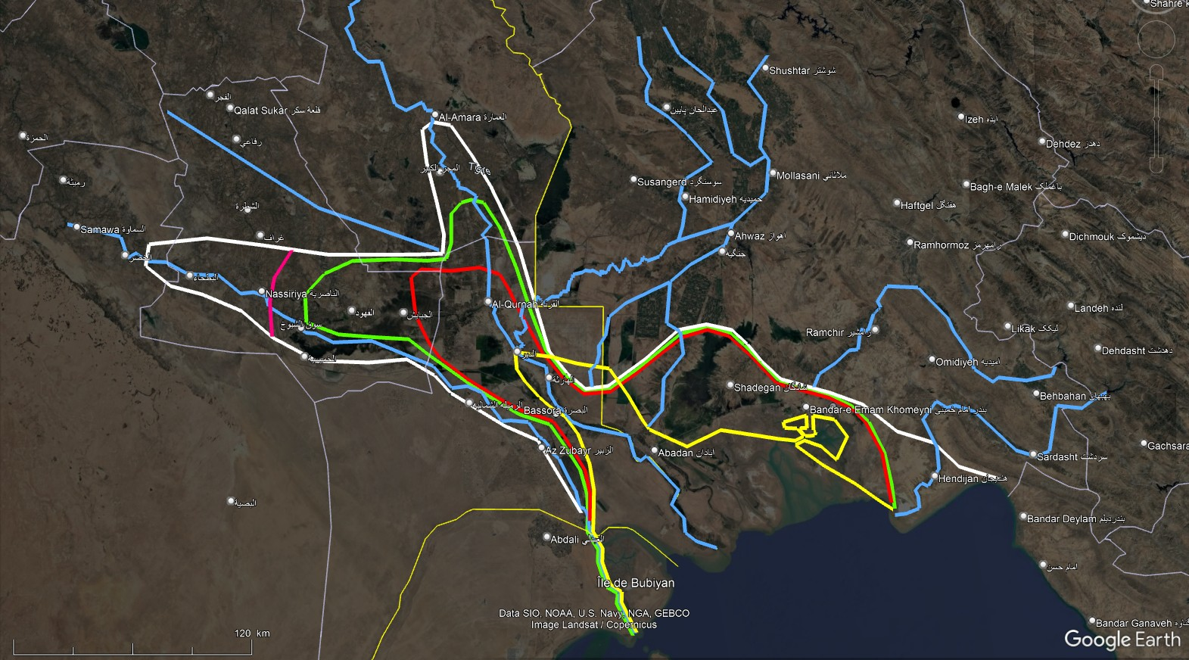
Tigris
Koprates
Choaspes
Modern
Karun
Archaic Tigris
Euphrates
Eulaeus
Coastline
4000 BC
Coastline
2500-2100 BC
Hedyphon
Coastline
2000-1800 BC
Mogaeus
Coastline
1500-800 BC
Oroatis
Coastline
700-300 BC
Pasitigris
Euphrates

Slide 3
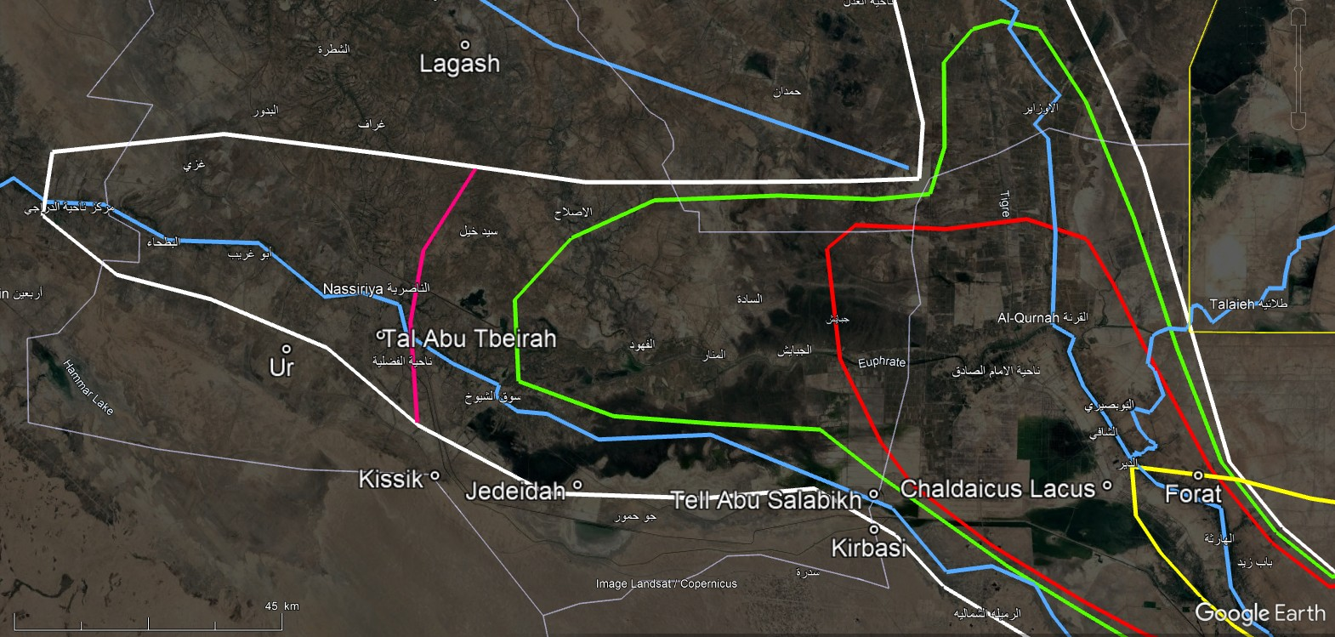
Archaic
Tigris
Coastline
4000 BC
Tigris
Coastline
2500-2100 BC
Euphrates
Eulaeus
Coastline
2000-1800 BC
Coastline
1500-800 BC
Coastline
700-300 BC

Slide 4
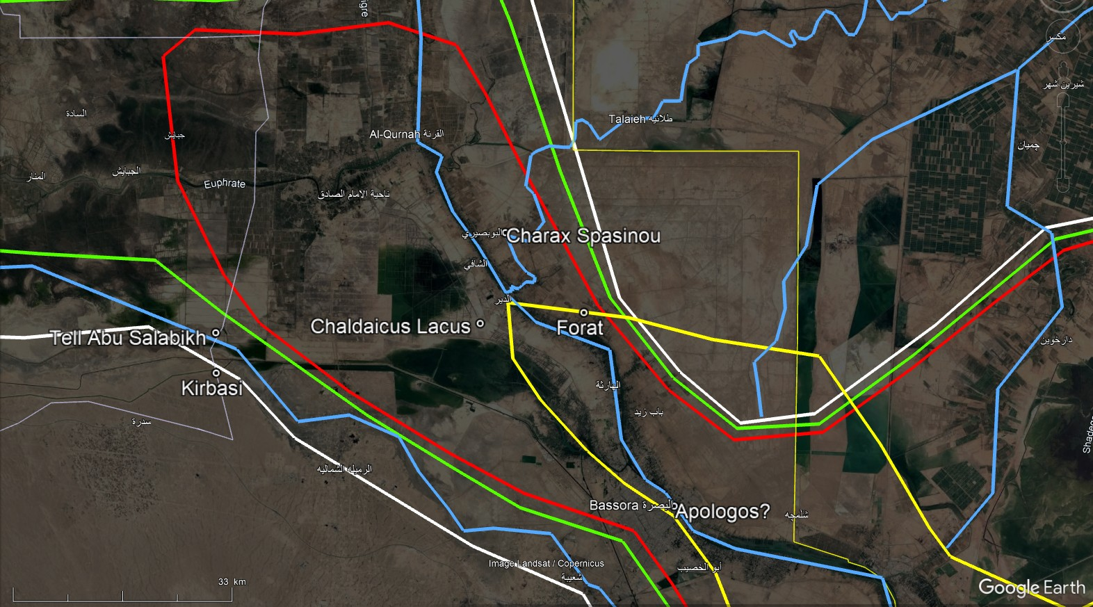
Eulaeus
Coastline
1500-800 BC
Tigris
Palaeo-Karun
("K1“)
Coastline
2000-1800 BC
Euphrates
Coastline
700-300 BC
Mogaeus
Coastline
4000 BC
Pasitigris

Slide 5
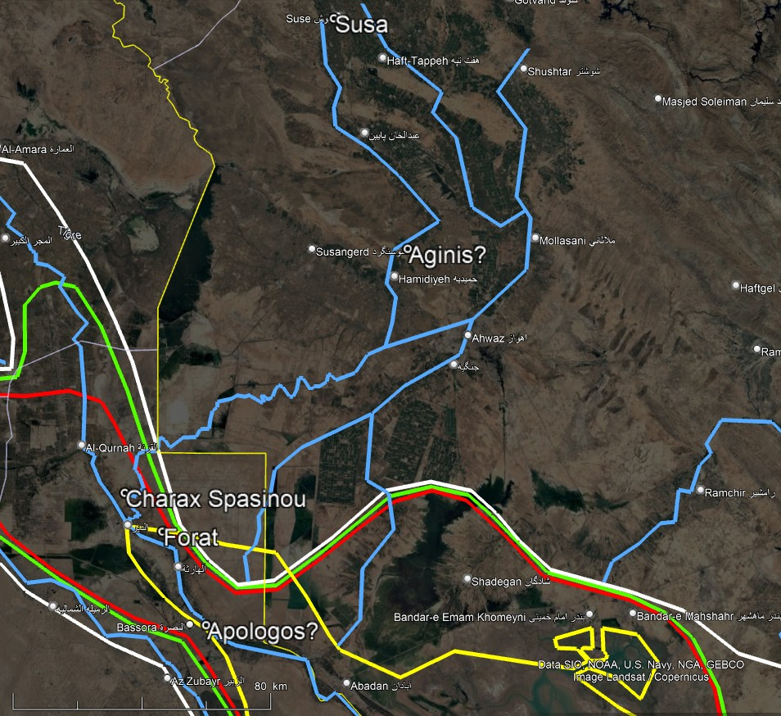
Koprates
(Dez)
Choaspes
(Karkheh)
Modern
Karun
Coastline
4000 BC
Tigris
"Kh1"
Eulaeus
(Palaeo-Karun "K2“)
Coastline
1500-800 BC
Palaeo-Karun
("K1“)
Mogaeus
(Karun "K3-K3b" )
Coastline
700-300 BC

Slide 6
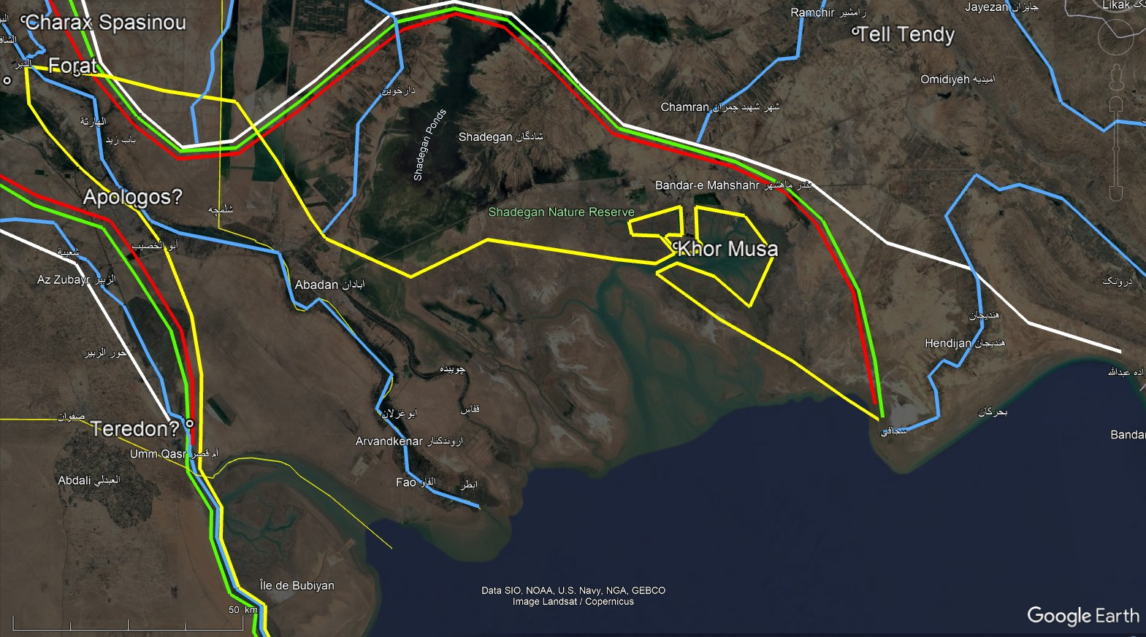
Coastline
4000 BC
Coastline
2000-1800 BC
Hedyphon
Coastline
1500-800 BC
Mogaeus
Coastline
700-300 BC
Pasitigris
Oroatis

